Slide 1
Front facing face does not need allocentric frame shift, so same reaction time as Roll.
Only after first yaw angle will allocentric frame shift be required.
If the face is located at the same place, the same frame shift will be used for all yaw angles, leading to a vertical translation of the data.
Yaw and pitch
Reaction Time
Time needed to perform allocentric frame shift
Roll
Angle of Rotation

Slide 2
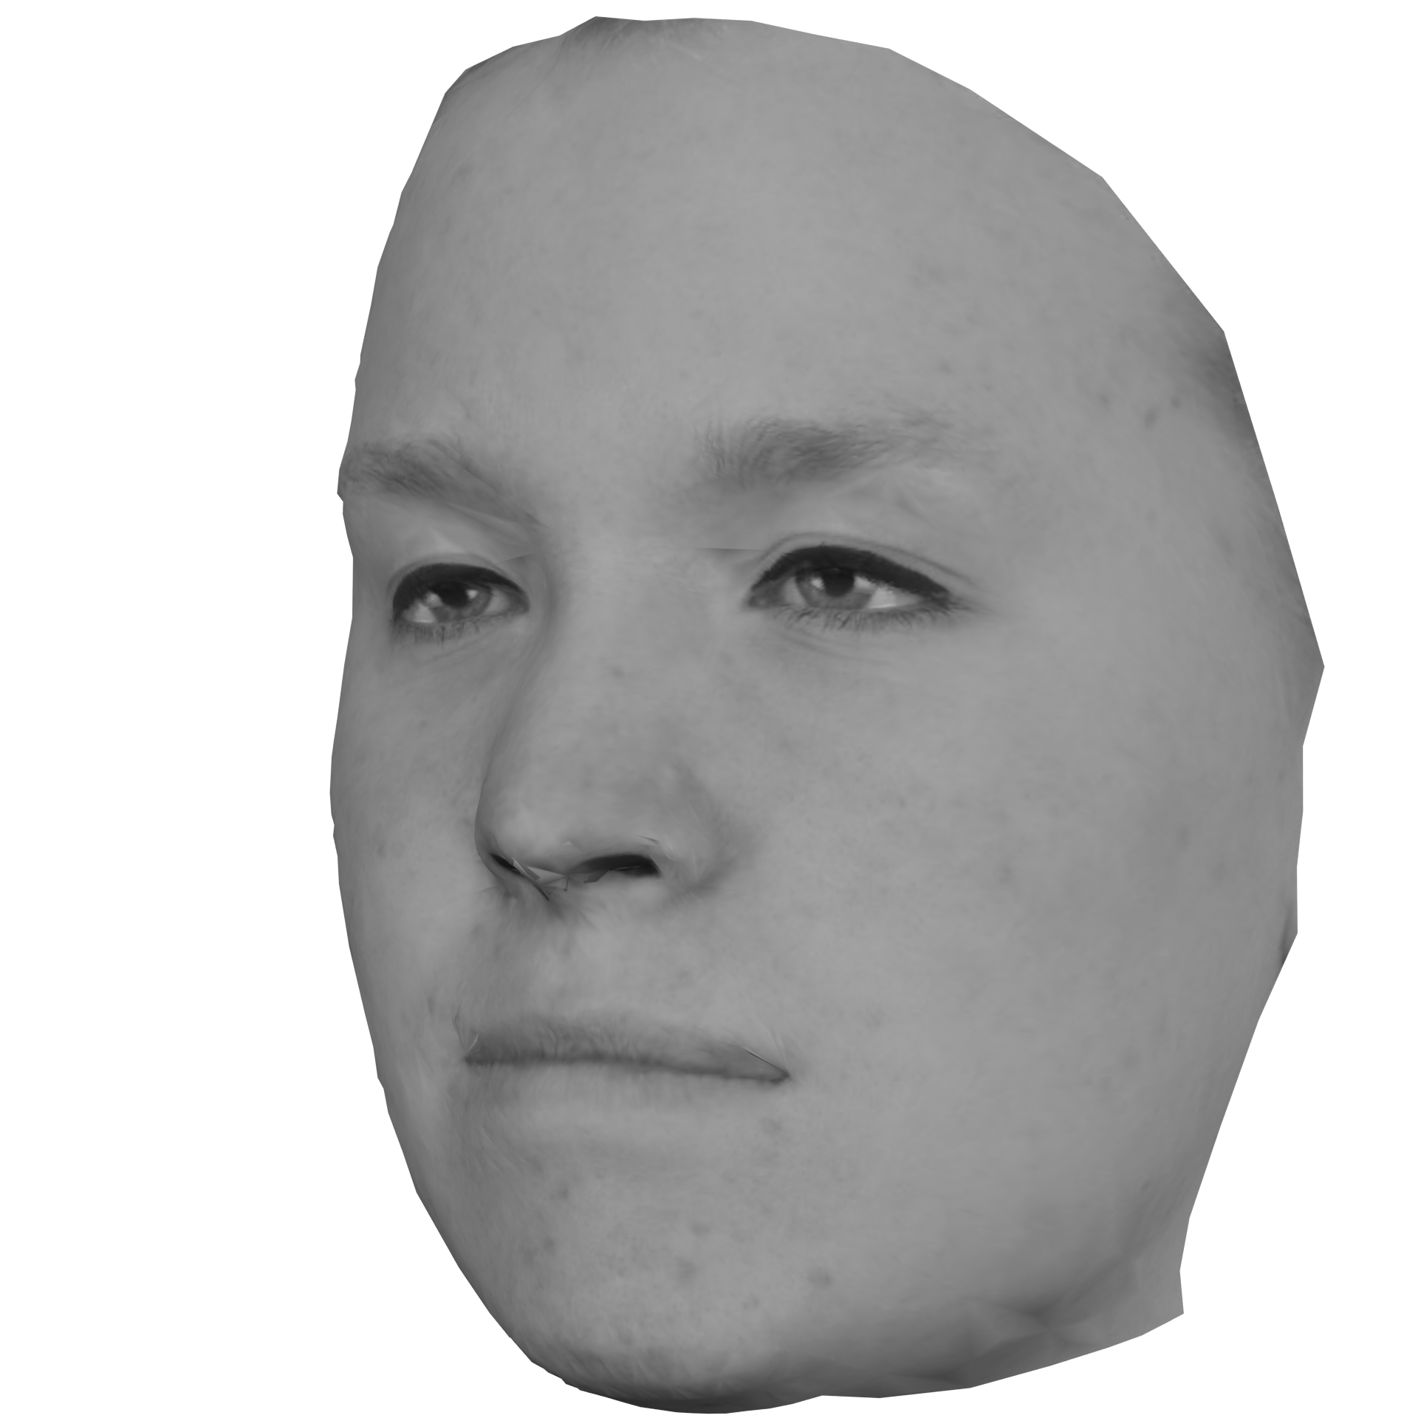

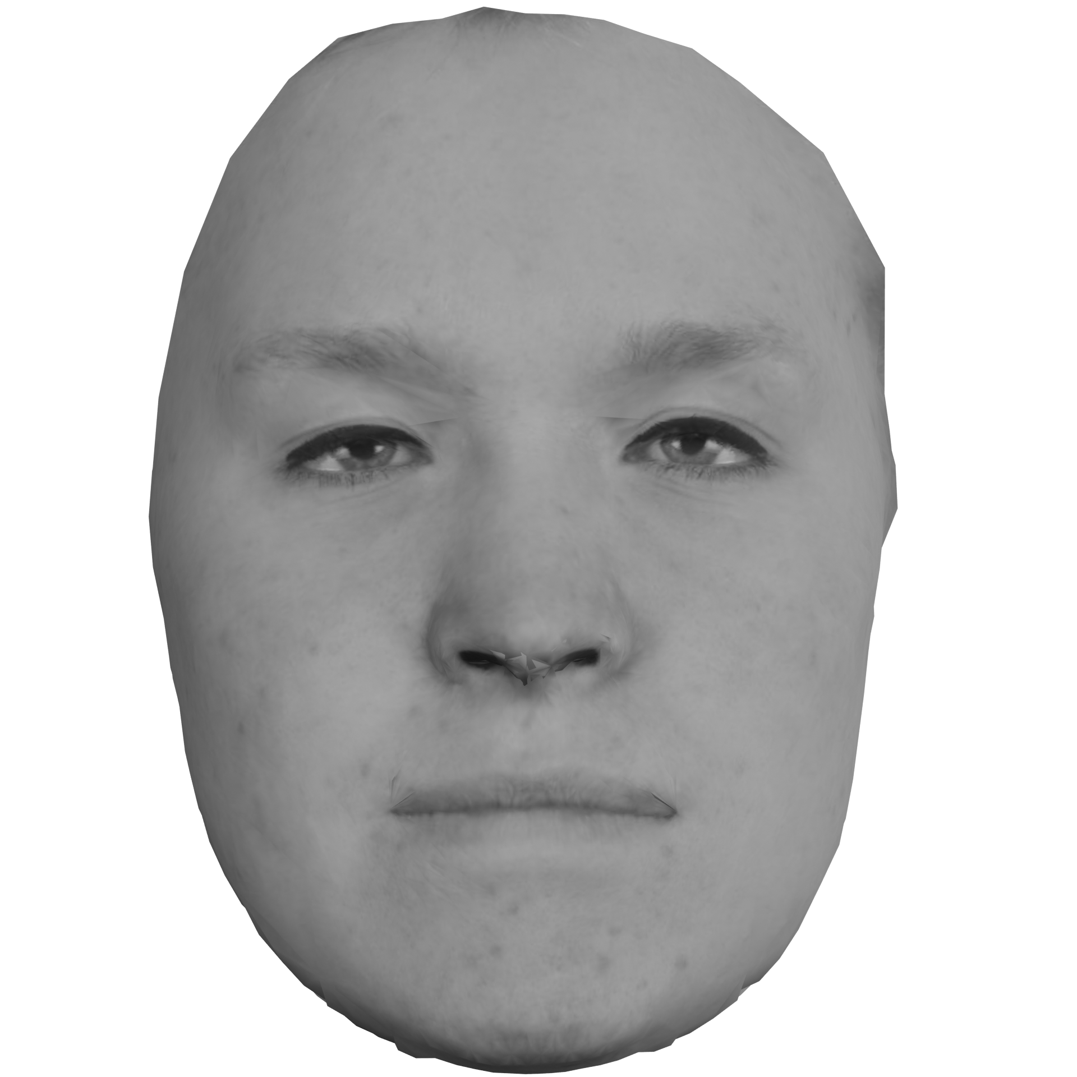

Because our brain has 2 systems, a cartesian system for translations and a log-polar system for rotation, yaw could be a cartesian translation (simply eccentricity) followed a rotation along the yaw axis in the log-polar system (simply egocentric yaw). Because horizontal translation would increase the radius to the eye, the scale can be adjusted in opposite axis of the log polar system.

Slide 3
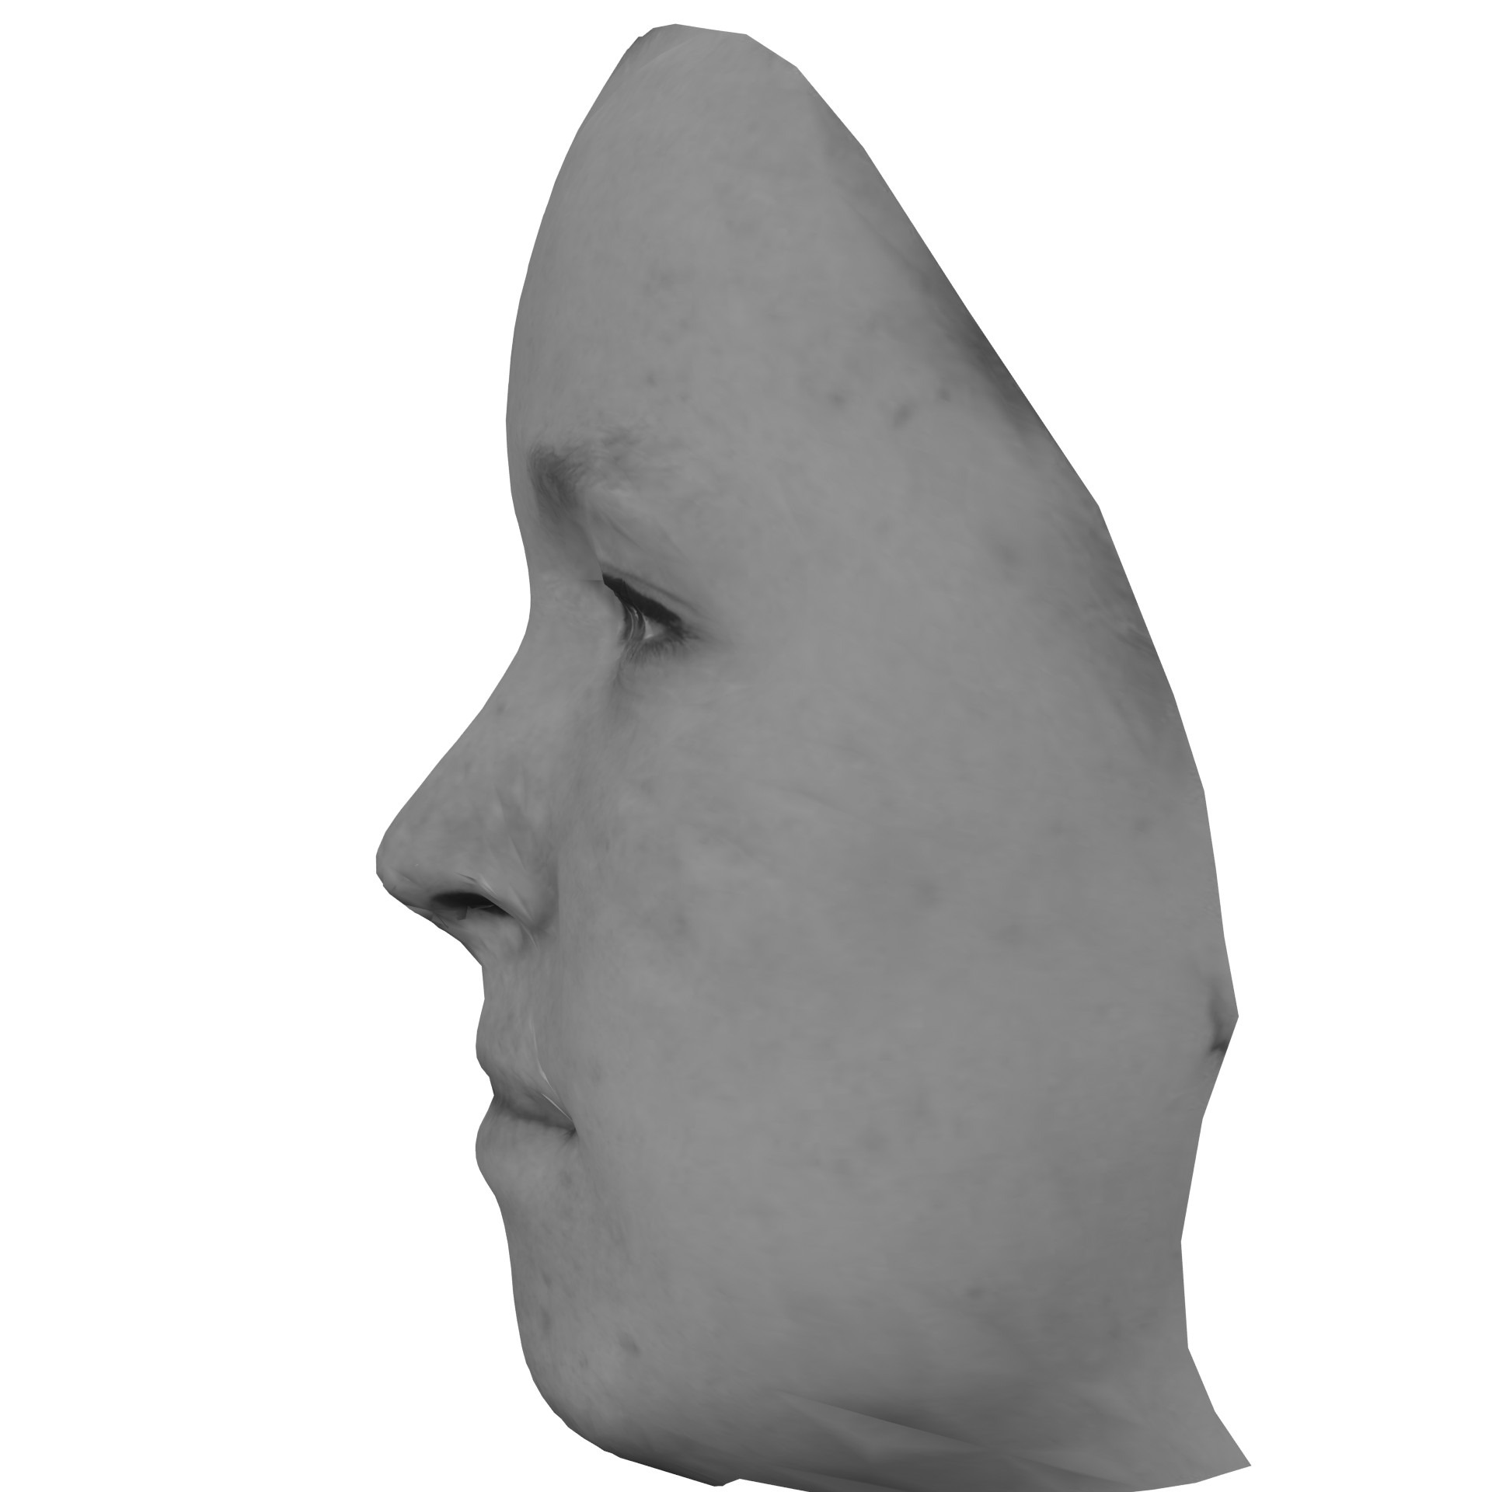
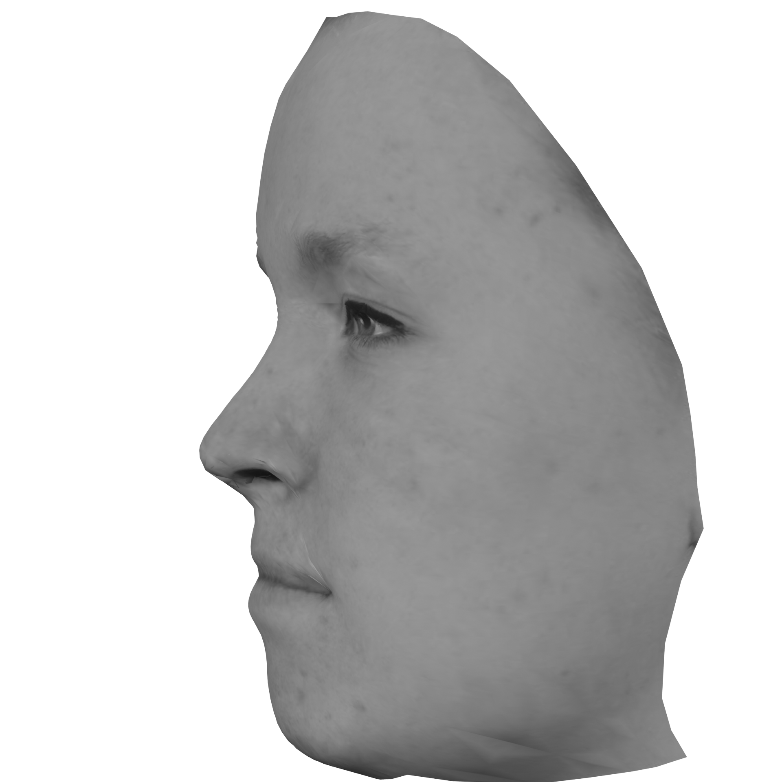
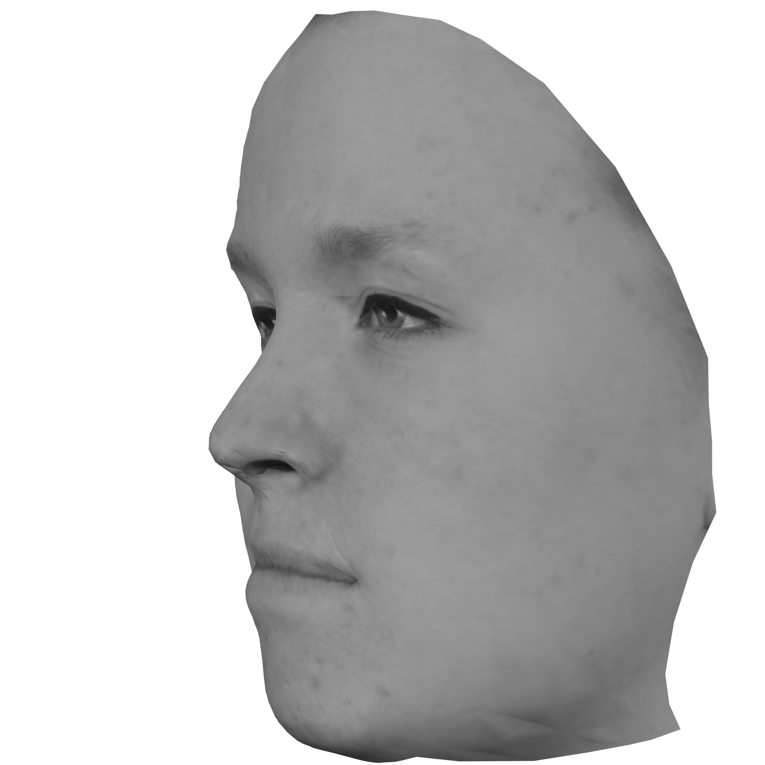
Set distance (infinitesimally small)
90 degrees would result in infinite horizontal cartesian translation if only 1 step and then a 90 degrees log-polar yaw translation.
However, if smaller steps, face will slowly be rotated towards center.

